Slide 1
Lesson 2 Chapters 3-4
Classes
Data types
Method overriding
Decision making
Creating objects
Arrays
Loops

Slide 2
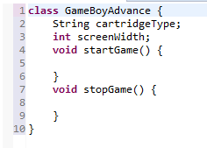
Classes
There is only one GameBoyAdvance class, but there can be many instances.
These are called objects.
Each object can have a different state.
Attributes define state
Methods define actions

Slide 3
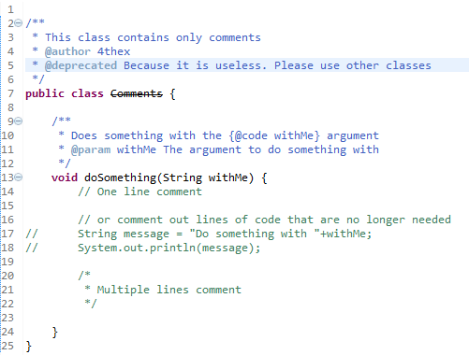
Comments

Slide 4
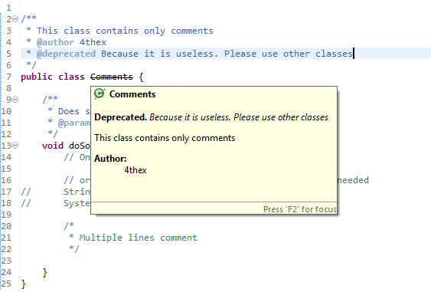
Comments

Slide 5
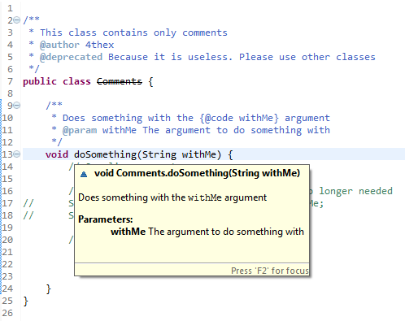
Comments

Slide 6
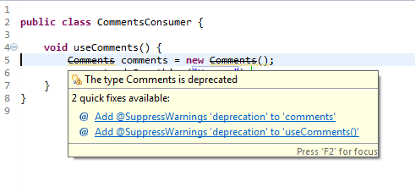
Comments

Slide 7
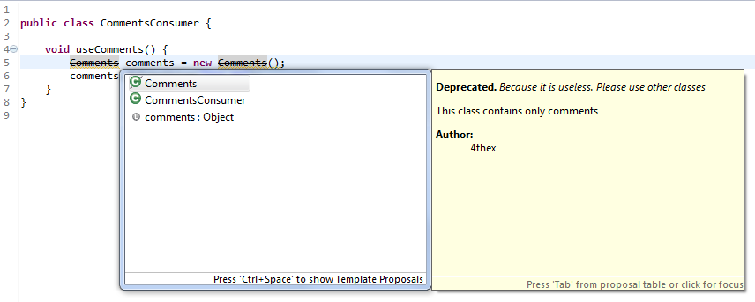
Comments

Slide 8
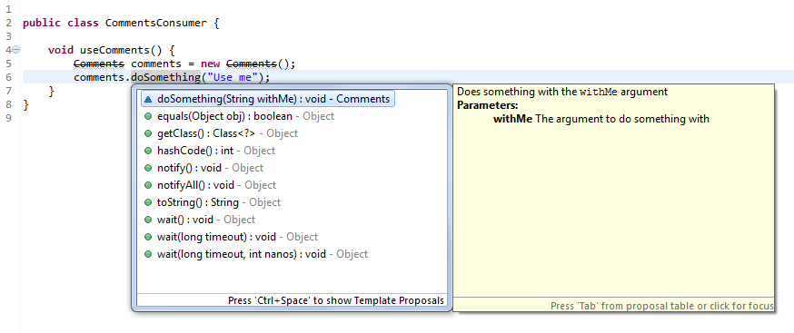
Comments

Slide 9
Data Types -Variables
Must be declared before use
Can be declared as
Attributes of a class
Arguments to a method
Variables inside a method
Can be assigned
Can be modified
Can be passed as arguments to methods

Slide 10
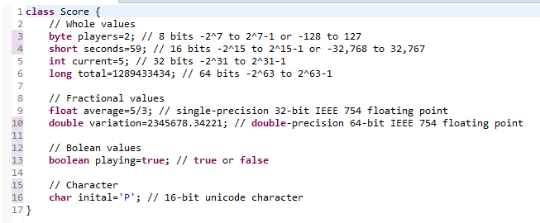
Primitive data types

Slide 11
Operations
+ : Addition
- : Subtraction
* : Multiplication
/ : Division
% : Remainder
++ : Increment
-- : Decrement
! : Not

Slide 12
Conditions
== : Equal to
!= : Not Equal to
> : Greater than
>= : Greater than or equal to
< : Less than
<= : Less than or equal to
&& : And
|| : Or

Slide 13

Inheritance
Not every animal can swim, so fish is a specific kind of animal
We use the keyword extends to indicate this

Slide 14
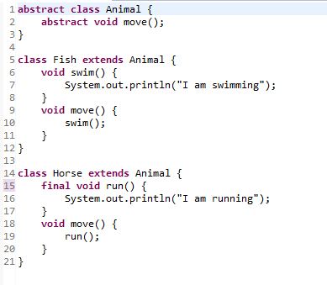
Method override
Use final to prevent override

Slide 15
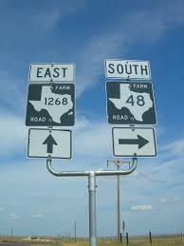
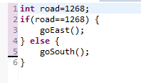
Making decisions

Slide 16
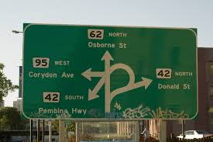
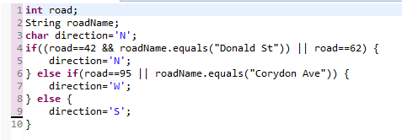
Combining conditions
|| or && : Only do second part of needed
| or & : Always do second part
Watch out!
= : Assignment
== : Condition

Slide 17
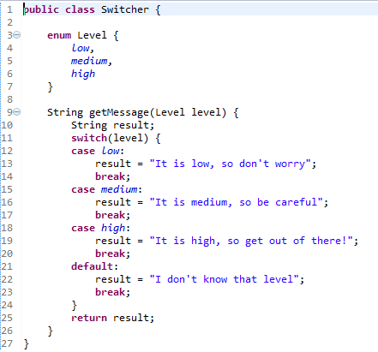
The switch statement

Slide 18
Variable lifetime
Variables declared inside a method dies when the method is exited. Local scope.
Variables declared as attributes of the class dies when the object instance goes out of scope.
Variables that are declared with the static keyword dies when the whole process dies.

Slide 19
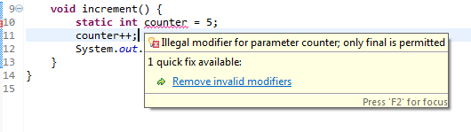
Static for C/C++ programmers
Notes:
You cannot have local scoped static variables in Java.

Slide 20
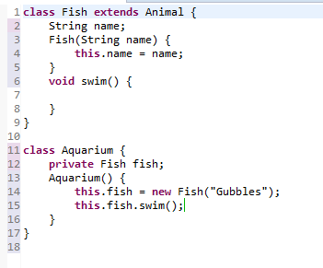
Constructors
Constructors are methods
Have same name as the class
Keyword ‘new’ calls a constructor.

Slide 21

Type constructor

Slide 22
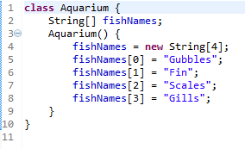
Arrays
First index is 0.
You can specify a literal
array in curly braces.
Has a fixed size.
All objects have the same type

Slide 23

Loops - for

Slide 24

Loops - for indexed

Slide 25
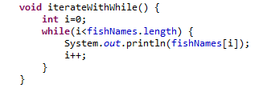
Loops - while

Slide 26
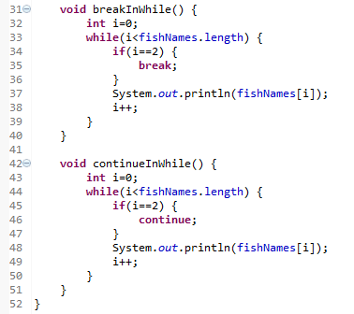
Loops - break and continue
‘break’ goes out of the loop
‘continue’ goes back to the
beginning of the loop
Do you see the problem?
Since variable ‘i’ is never
Incremented, the loop runs
forever.

Slide 27
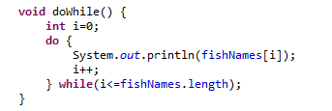
Loops - do while
Do first, validate after
Careful! This kind of loop will always run at least once.

Slide 28
References
Java Language Tutorial
http://docs.oracle.com/javase/tutorial/java/
Java Language Specification
Not for the faint of heart! Don’t even go there unless you are an aspiring law student.
http://docs.oracle.com/javase/specs/jls/se7/html/index.html
Java API Documentation
http://docs.oracle.com/javase/7/docs/api/

Slide 29
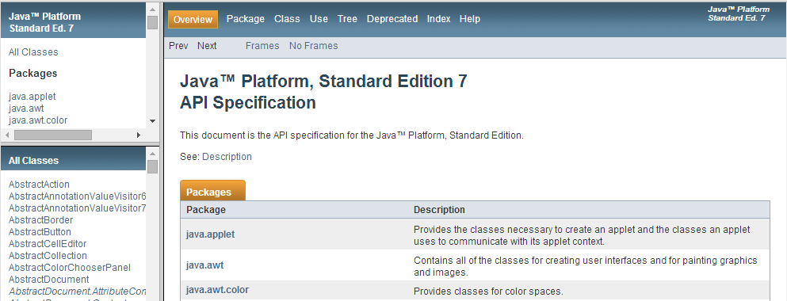
API Documentation
Notes:
This is generated from the Javadoc comments of the API classes themselves.

Slide 30
Assignment
Start developing your own project
Create a description of the main features
Push some code into the Sandbox repository under a folder with your GitHub user id.

Slide 31
Importing Sandbox

Slide 32
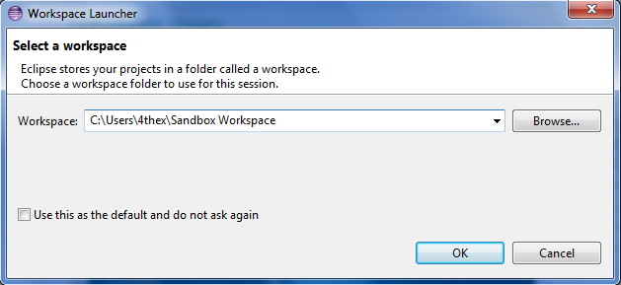
Choose your workspace

Slide 33
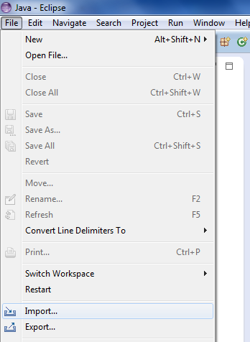
Import

Slide 34
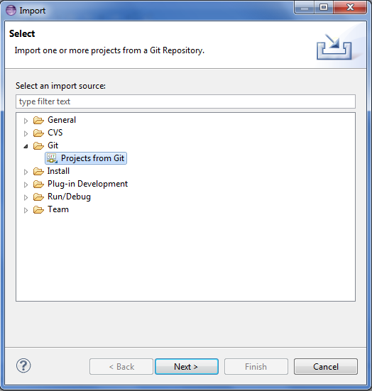
Project from Git

Slide 35
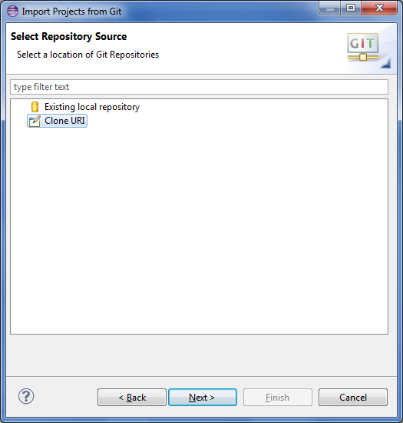
Clone URI

Slide 36
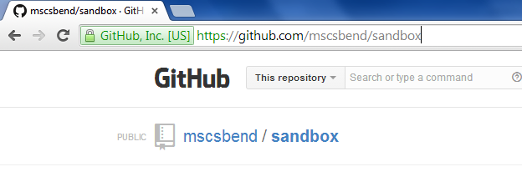
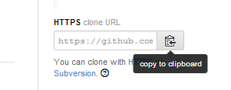
Clone URI
https://github.com/mscsbend/sandbox.git

Slide 37
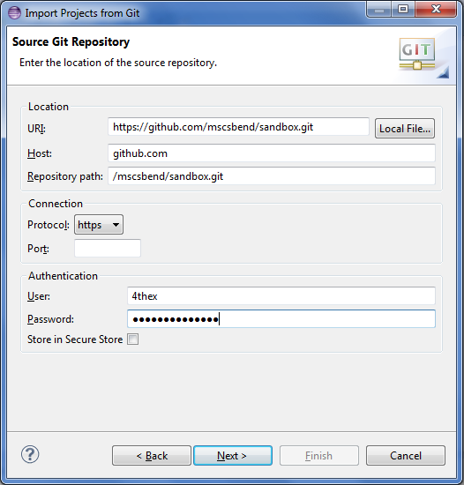
Clone URI
Paste

Slide 38
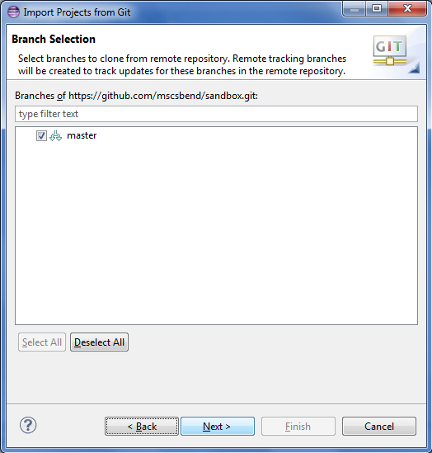
Branch

Slide 39
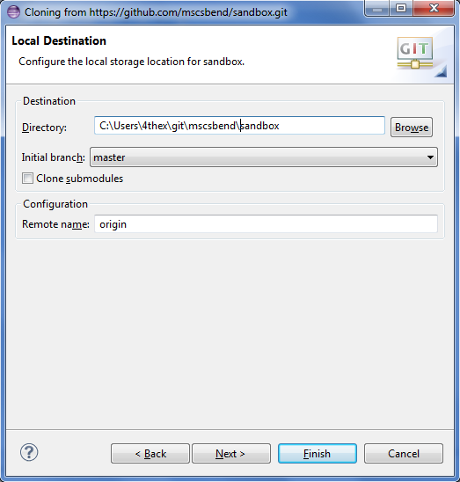
Local Destination

Slide 40
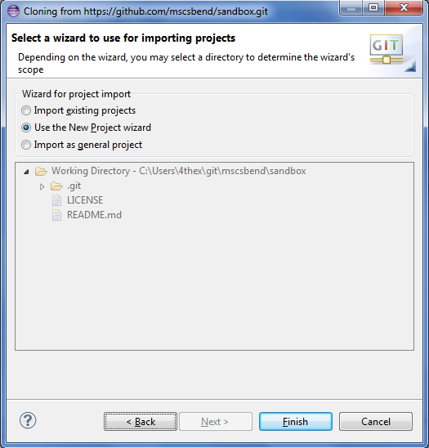
New Project

Slide 41
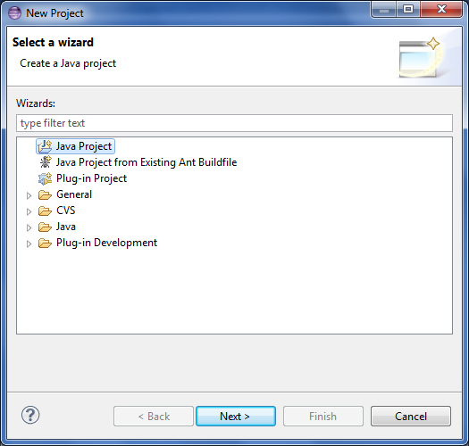
New Project

Slide 42
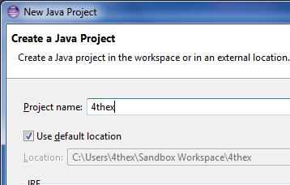
GitHub user name

Slide 43
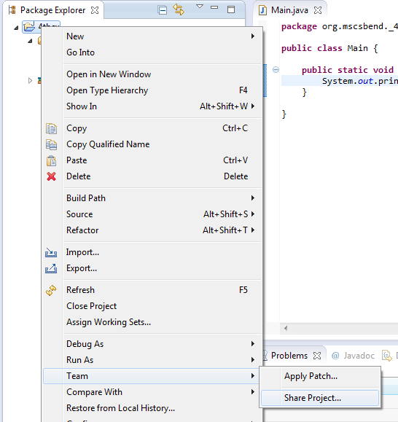
Share

Slide 44
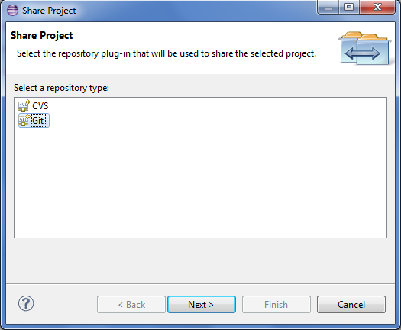
On Github

Slide 45
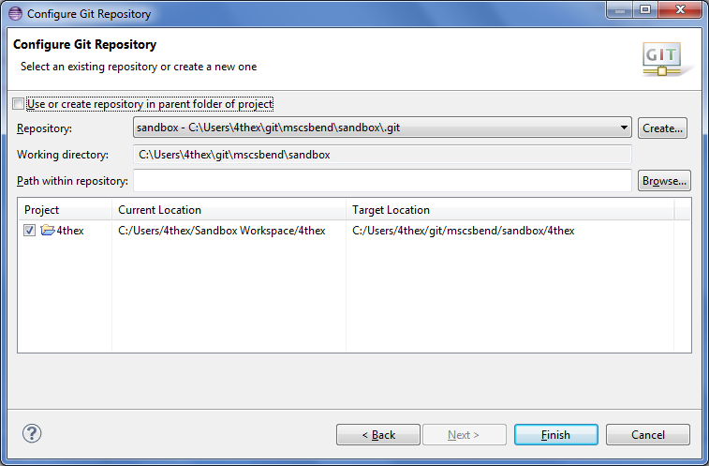
On Github

Slide 46
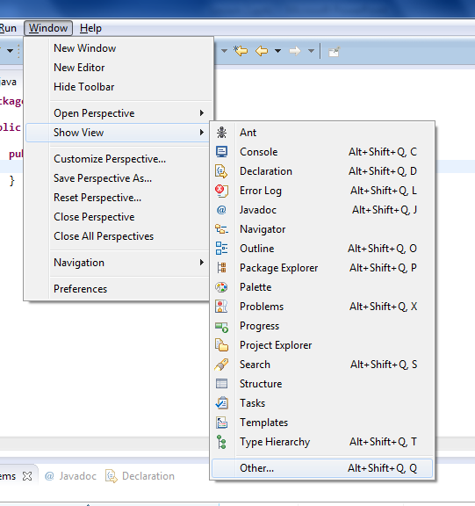
Push

Slide 47
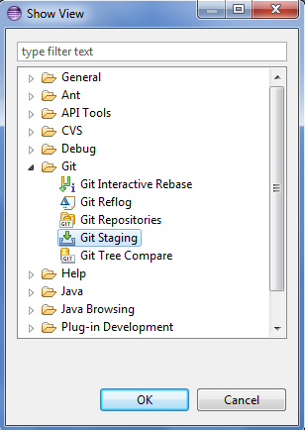
Push

Slide 48
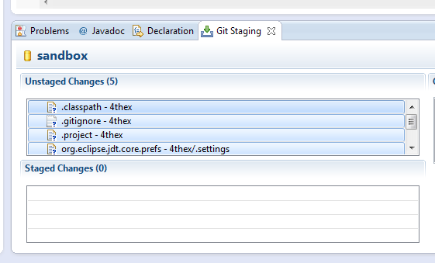
Push
Drag and Drop

Slide 49
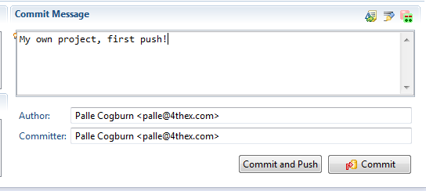
Push

Slide 50
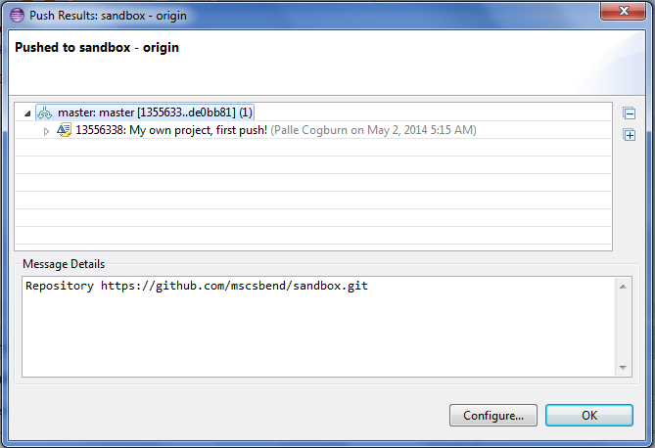
Push

Slide 51
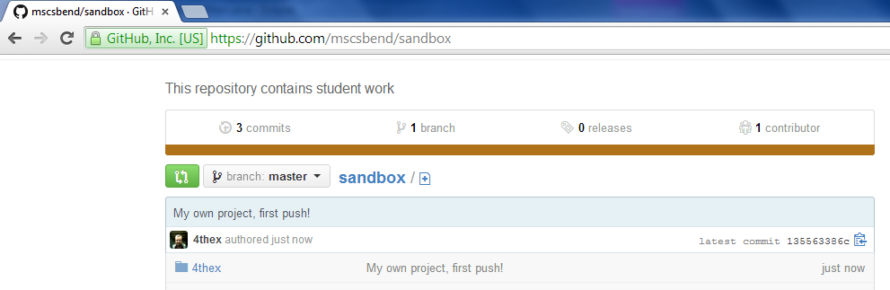
And there it is!

